Slide 1

Career Growth & IDP

Slide 2
New Career Reality

Slide 3

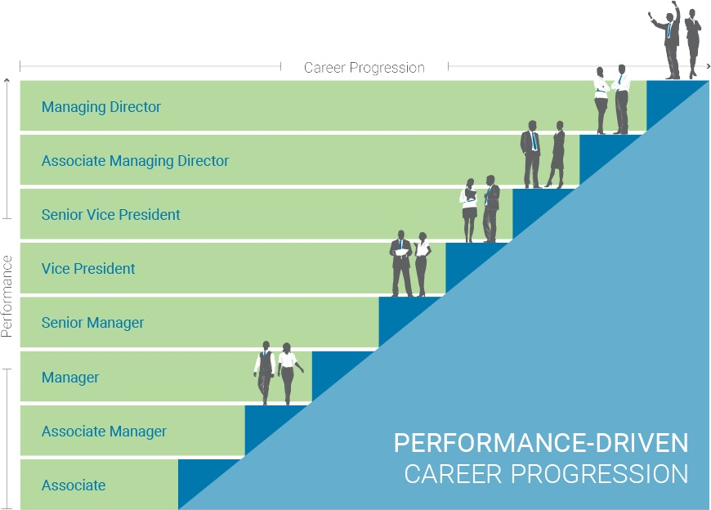


What does career mean to you?
dramatic shifts in technology, society and global economics ARE re-defining work and re-shaping careers
Mastering and Succeeding in your current role
A road to the future and roles it brings
A journey of
POSSIBILITIES
A succession of opportunities to increase Breath and Depth of experience

Slide 4



CAREER 'RULES' HAVE CHANGED
NEW RULES
The idea of a
single, Hierarchal Career
IS
no longer reality
Career development means upward progression
New positions are offered to me
My manager mainly helps me plan my career
Career Ladder
Taking on a new assignment can be risky
It takes a long time to become a senior leader
Career opportunities mean NEW experiences
I SEEK out and FIND new opportunities
I FIND new opportunities to constantly grow in my career
Career Lattice
Gathering critical experiences is the KEY to moving forward
Leadership is offered ALL the time
OLD RULES

Slide 5
TODAY’s CAREERS ARE GROWTH BASED
effective careers today are built around GROWTH Not positions
Careers Traditionally Designed Around Positions
Aspiration: Functional Leader
Functional Leader | Functional Leader | Functional Leader
Project Manager | Consultant | Project Manager
Project Lead | Business Analyst | Lead Consultant
Senior Associate | Junior Business Analyst | Senior Technical Consultant
Junior Associate | Business Associate | Junior Technical Consultant
Critical Experiences
Profit margin calculation
Preparation of project risk assessment
Leading key customer relationship
Opportunities for Gaining Them
New business development role
Finance and economics modules
Operational or audit role
Shadowing a current risk assessor
Commercial role
Mentoring by commercial leader
Leadership Capability
5

Slide 6

CAREER MOVEMENTS
A career path likely will include moves OTHER than vertical:
Enrichment: Growing in place
Exploratory: Investigating possibilities
Vertical: Moving up
Realignment: Re-contracted assignment
Relocation: Opportunity in other geographical area
Lateral: Moving across functions/roles/businesses

Slide 7


You may not be able to determine your exact career path Now …but you can steer it towards your North Star.

Slide 8
AFG Career Growth Model

Slide 9
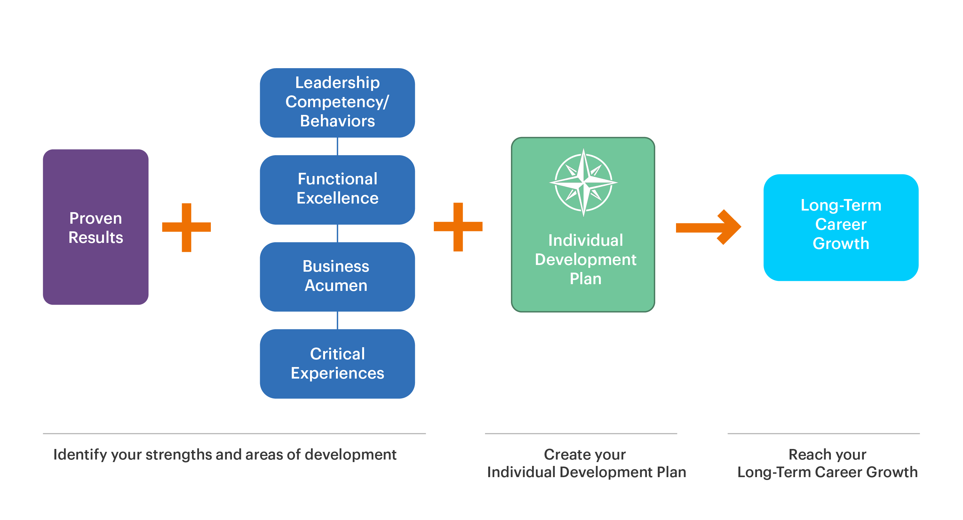
AL FUTTAIM CAREER GROWTH MODEL

Slide 10

PROVEN RESULTS
Demonstrating consistent and superior results is essential for consideration for new opportunities
Demonstrating consistent performance rating for at least 2 cycles
Understanding that Business growth drives personal growth
Understanding that it’s unlikely that one success will make a career or that one failure will end it
Acknowledging that it's not only important to achieve results, but also how results are achieved
Maintaining primary focus on achieving your current role’s objectives.
Notes:
Review your PMP evaluation and identify areas of opportunity.
Seek feedback throughout the year through CPM to ensure you are on track on you goals & development plans

Slide 11
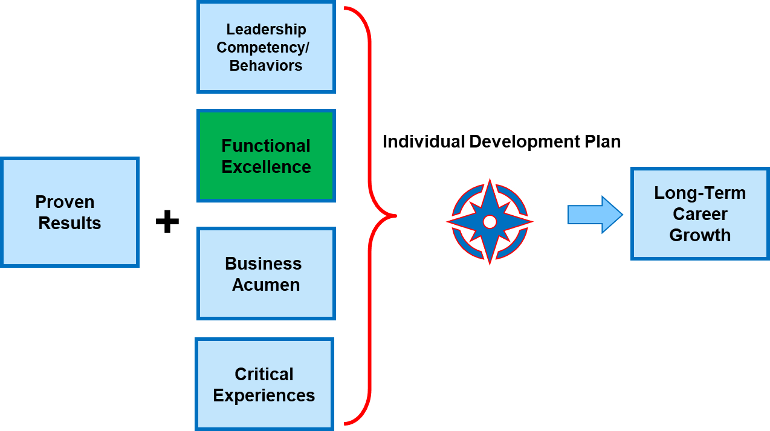

FUNCTIONAL EXCELLENCE
Demonstrating technical mastery of current role and driving continuous improvement
Notes:
Check functional skills inventories and frameworks (Functional Competencies if available)
Ask your manager on what you need to do to gain functional excellence
Stay current in your field/function
Leverage Self-directed learning
Seek feedback, and self reflect.
Understand what comes easy and gets you passionate in your work, these are probably your strengths.
Understand how you can leverage those strengths further, potentially in different areas of your role.
Understand what are the areas that you tend to struggle in, seek guidance on how to close the gap.

Slide 12
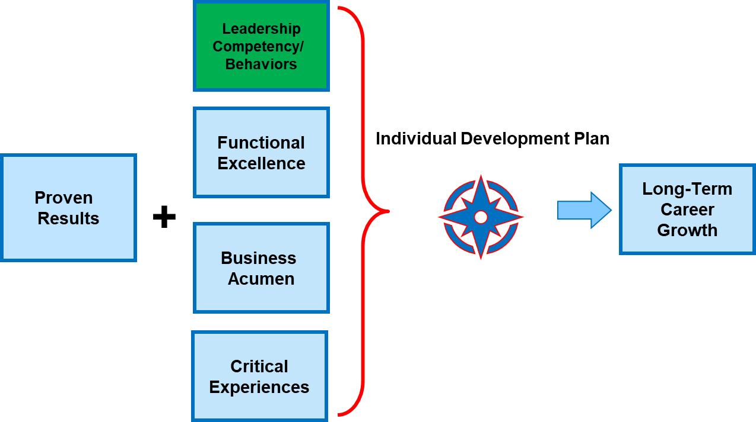
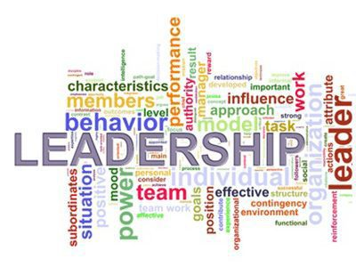
LEADERSHIP COMPETENCY/ BEHAVIOURS
You need to understand the leadership competencies/Behaviors & ask your self what are your areas of strength & what are your areas of development?
You need to discuss this with your manager to be able to understand what you need to focus on
You can leverage the 360 tool to provide you with a unique opportunity to gain insight on how your Leadership behaviors are being demonstrated and perceived.

Slide 13

BUSNIESS ACUMEN
Having a broader knowledge of the business in order to see the big picture.
Understanding key business drivers and financial indicators for success.
Knowing your own division, as well as others.
Understand what is driving the business growth today & what are the external factors that are impacting the business both positively or negatively.
Know what are the key strategic levers we are driving and how am I contributing to this
Notes:
Explore roles in others parts of the business!
Ask your manager to join cross-functional sessions projects/trainings.
Check out business & division / team websites, including LinkedIn Learning
Learn about the key drivers of our business and keep track of them.

Slide 14
CRITICAL EXPERIENCE
Many career journeys involve unexpected turns. That’s why your growth is not only about changing roles. It’s also about gaining a diverse set of critical experiences that fuel your career and make you more agile and able to take on new opportunities.
A CRITICAL EXPERIENCE IS:
A way to develop and refine your capabilities
Aspirational for future needs/strategy
An enabler of career growth throughout the organization
Based on knowledge of what’s required to move the business forward
Immersive - gained day to day (“on-the-job”)
Able to be duplicated - experiences multiple people can have (e.g., sectors, geography, category, etc.)
Challenging & tough to be able to reach your goals (e.g Hardship assignment)

Slide 15

WHAT IS AN IDP
Individual Development Plan (IDP) is a tool to organize and target your development needs.
Its primary focus is to help you strengthen your current job performance and achieve short to long term career goals through a structured, well-rounded approach.
It can include a combination of interventions, such as experiential on the job learning, social learning through others and/or classroom/eLearning which is aligned with your line manager during your Career Conversation

Slide 16
WHY DO YOU NEED AN IDP
Lays out the employee career ambition and objectives and the path to take towards achieving them.
Aligns employee career aspirations with business needs and strategy
Ensures that the employee is continuously provided with the opportunity to learn and stretch within a continuously changing business needs
Sets up clear expectations between the employee and the manager
Increases Employee engagement and retention.

Slide 17
The How

Slide 18
WHAT I WANT VS WHAT I AM?
Motivation
Aspiration
Honest Career Conversation
Self-awareness
Notes:
Activity # 1- 15 min
Open the pre – Career Conversation Reflection. Think of what are your career Aspiration, Self-awareness & motivation. Answer the question under each one in order to be able to understand more about what you want.
Discussion
Each one will share some of the answers they captured and share their reflections after they answered the questions.

Slide 19
BUILDING YOUR DEVELOPMENT PLAN
Building a development plan is a shared responsibility between the employee & his/her line manager, where the employee is in the driver seat & the manager enables, facilitates and supports the execution of the plan
Asses where the learning needs to happen (current or future role).
Understand the current Strengths and Areas for Development through:
Feedback received from different stakeholders (manager, peers, customers etc.)
Technical (where present) & Leadership Competencies
Performance Evaluation/ 360 feedback/ additional assessments including external
Job Description
Understand How you learn Best
By Doing
By Observing others
By Understanding the theory
Match learning needs to learning interventions.
Keep in mind that an IDP is not only about addressing development needs, it is also about strengthening and leveraging current strengths
Notes:
Understand how you are doing today vrs expectations of your role, what is your ambition, understand what this means in terms of new technical capabilities, behaviors, mindset, experiences. Use these reflection points to drive a conversation with your line manager, gain alignment on what to focus on, discuss ways to address those learning needs keeping 70:20:10 and your learning style in mind.

Slide 20
JOB SPECFIC SKILL
Sales | Marketing | Finance
CRM Sales Force Inventory management | Copywriting Digital Media Content Creation | CPA CMA IBM Cognos Controller
HR | IT | Legal
Job Evaluation CBI Labor law | ERP Systems Java Script CSS | Employment Law Legal Writing Appeals

Slide 21
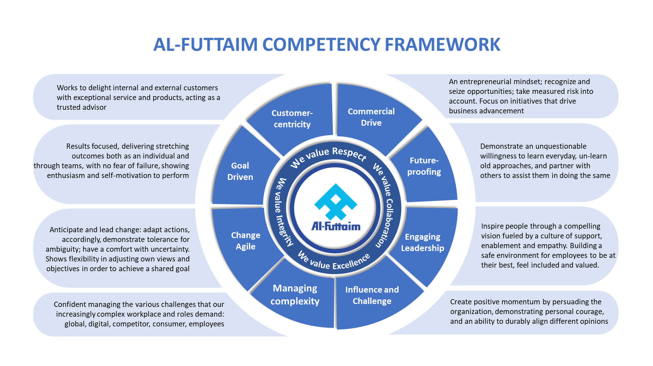
LEADERSHIP COMPETENCIES

Slide 22
AL FUTTAIM CAREER GROWTH MODEL
Identify strengths & gaps

Slide 23
IDENTIFY THE GAPS
Building a development plan is a shared responsibility between the employee & his/her line manager, where the employee is in the driver seat & the manager enables, facilitates and supports the execution of the plan
MY AREAS OF STRENGTH | MY AREAS OF DEVELOPMENT
Notes:
Activity # 2- 15 min
On the IDP workbook Page 1 start assessing yourself on where you are and where are you going to help you in building your development plan
Discussion
Each one will share some of the answers they captured and share their reflections after they answered the questions.

Slide 24
DEVELOPMENT AREA
My Development Areas
Notes:
Activity # 2 – 10 min
Based on the reflection points & feedback you wrote down in the previous activity, what are the development areas you wish to focus on. Prioritize 2-3 development areas.
Discussion
Ask some of the participants How many skills they already acquired. What are the steps they are taking to acquire those skills.

Slide 25

HOW YOU LEARN BEST
As adults we all have a preferred way of learning, some learn best by doing, others by observing others do, and others prefer to understand the theory behind.
Whichever is your preferred style, it is important to do a bit of all three approaches to embed the learning.
However start your learning journey with the approach that comes easiest to you.

Slide 26
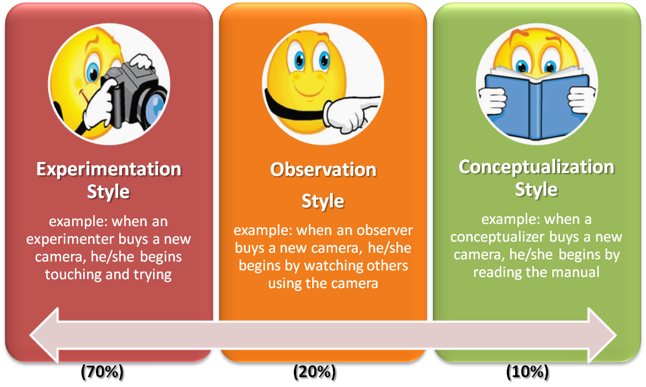
LEARNING STYLES

Slide 27
LEARNING APPROACH
The 70/20/10 learning approach is a widely used learning and development model which captures three types of learning: experiential, social and formal. The "70/20/10" ratios are an indication of the proportion of learning time someone might spend on each type of learning to get the most from their development. Whilst the proportions are only indicative, they are strongly embedded in adult learning theory.
70% - On the Job Learning
20% - Social Learning
10% - Classroom/e-Learning

Slide 28
What can I Do
70% - On the Job Learning
Secondments, stretched assignments or lateral moves to acquire skills and knowledge you wouldn’t get from working in your current role. Projects or participating on a working group within or outside your usual working area. These can give individuals the opportunity to develop new skills or work with other business areas Being a mentor or trainer around your area of expertise Job enlargement, taking on additional tasks that would not be part of your regular job scope. Double hatting, taking on an additional role beyond your own, and being exposed to new tasks Participating in level up strategic meetings
20% - Social Learning
Joining communities of practice or subject matter networks to enable learning through the experience of others Job shadowing - to learn about a different role, particular aspects of a role or work area and what it involves by observing the current role holder. Coaching – either from the line manager or other experienced coaches, supporting the employee to find their own solutions to challenges being faced. Being mentored by an expert in the particular area of interest. Conferences can be great places to build networks and understand how other people approach challenges you face
10% - Classroom/e-Learning
Workshops or other face to face courses: these may be external or internal to the division Webinars and Instructor led Virtual learning e.g. DriveIn/ LEAD Linkedin learning and other e-Learning modules available on iGrow Reading books/articles on relevant topics to stay up to date on the latest thinking.

Slide 29
70% - On the Job Training
Being part of/leading a project. Joining cross functional Project that will work together on building a dashboard. Request for opportunity to present during your team/department meetings Look for the opportunity to be part of a cross functional project
20% - Social Learning
Shadow a colleague who is strong in presenting through the whole process of structuring, developing and delivering Get mentored by business leader on ways to work in unstructured environment. Attend a peer learning circle and participate in the working groups. Job shadow the reporting & analyst specialist in your teams
10% - Classroom/e-Learning
Attend the Presentation skills training that is on drive in calendar Enroll in the reporting & analysis certificate. Read the leading change book for Kotter. Listen to Tedtalks about the importance of teamwork.
Notes:
Activity # 3 – 10 min
Use the IDP workbook page 3 & use the small Cards that we distributed.
Each Participant will have 4 development goals
You need to place the development card on the type of intervention that is relevant to your development goals
Development Goals:
I want to get better at presenting in public
I want to improve my ability to work in teams
I want to develop my analytical skills
I want to work on my ability to work in ambiguity & change
Discussion
Share what is your best learning approach & why

Slide 30
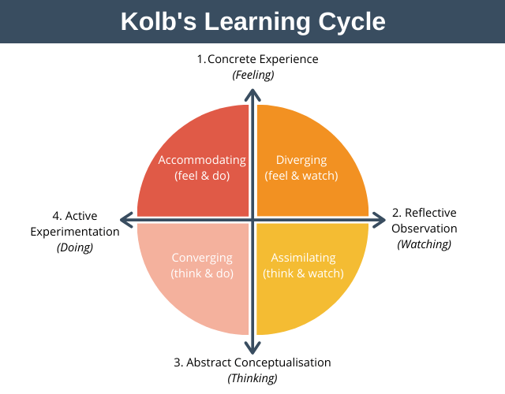
How you Learn BEST
As a learner you can enter the cycle at any point, however it is important to close the cycle by experiencing all four quadrants.

Slide 31
KEEP IN MIND that Development GOALS on IDP
Should be relevant to your individual performance and career aspirations and be realistic/attainable.
Should take stakeholder's feedback into consideration while crafting development goals.
Should concentrate on ways to leverage strengths as well as improve areas where you need development
Should be SMART – Specific, Measurable, Achievable, Realistic and Time bound.
Should apply the 70/20/10 rule, 70% of the development plan should be focused on on-the-job experiences, 20% on social such as mentoring & coaching, and 10% of formal classroom/computer-based training/e-learning.
Should Gain manager support to help you strengthen organization’s commitment to your development goals and also creates mutual accountability for achieving your development target.
31

Slide 32
INDIVIDUAL DEVELOPMENT PLAN EXAMPLES
Development Objective | Skills/knowledge & behaviour | Action steps/learning activity | Organizational/manager support | Success measures | Target Date Completion
Drive a culture of innovation in my team to enhance our customer centric approach | Innovation & Engagement | For the staff or teams you lead, set up monthly innovation sessions to discuss new ideas. Read about tools and techniques to facilitate design thinking sessions Solicit input from multiple sources, including your juniors, before making a decision. | Provide coaching on how to drive team innovation. | Engagement Survey (culture question) | July 2022

Slide 33
INDIVIDUAL DEVELOPMENT PLAN EXAMPLES
Development Objective | Skills/knowledge & behaviour | Action steps/learning activity | Organizational/manager support | Success measures | Target Date Completion
Notes:
Activity # 4 -10 min
Use the IDP workbook page 5 and fill in two of your IDP
Discussion
Share one goal and the other participants will judge if its SMART or not

Slide 34
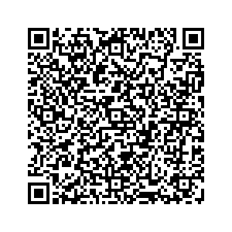
ESCAPE ROOM - IDP

Slide 35
Making it a GOOD Career Conversation
Accept feedback from you manager & be open to consider different perspectives in order to Progress & move forward.
Ask your manager who can support you with the development goals, such as :
Matrix manager
Mentor /A coach from within or outside the Division
Trusted peers
Subject matter expert/Senior Professional in the area you want to develop skills or a career
Stakeholders who can provide useful feedback on your strengths and areas for development
Have a balance of short-term goals with a longer-term ambition
Focus on Development rather than when is my next Promotion.
Make sure you understand all points discussed and align your manager to your IDP.
Update your IDP in IGrow and start moving towards your career goals TODAY
35

Slide 36
LONG–TERM CAREER GROWTH
Understanding how to build your own career is the foundation to reach your career aspiration & long-term career growth.
Careers are long-term in nature and the best ones evolve thoughtfully

Slide 37

Creating a culture of Continuous Performance Management
Notes:
Getting people to talk -

Slide 38
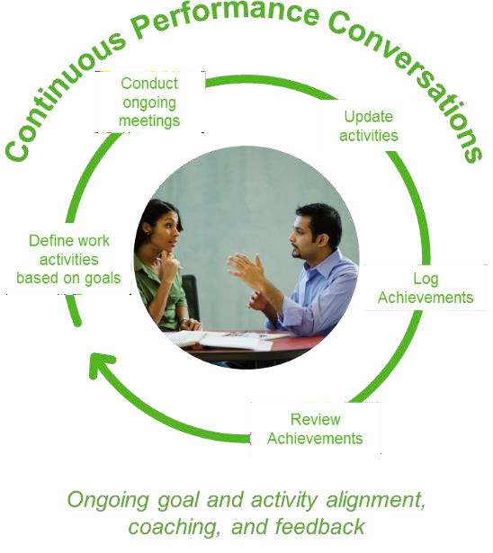


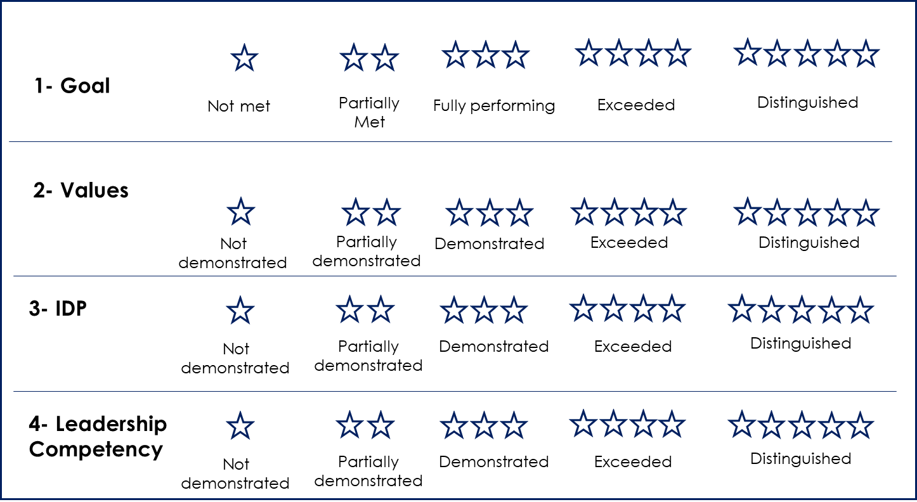
PERFORMANCE MANAGEMNT PROCESS
Year-round feedback to monitor progress on goals and projects
Employees/Managers can realign expectations at any point in time
Coaching is at the heart of the PM cycle
Establish Goals
End Year Review
Goals are not locked throughout the year to allow a more flexible process
Enabled Team Goals
Enabled Group Goals
38
Notes:
Did you know that we do not have mid year reviews anymore, so how do you track and checkin progress of your employees? What is the difference you see here with traditional PM processes.
Get people to discuss.

Slide 39

OUR EMPLOYEES POWERFULL VOICES ECHO
POSITIVE
FEEDBACK
AREAS TO
IMPROVE
1 Role clarity
2 Collaboration
3 Customer centricity
Excellence
Al Futtaim as a place to work
Manager takes an active interest in my growth and development 78%
Communication 70%
Effort to listen to opinions
Recognition & appreciation 75%
Work life balance 71%
Source: Growing together survey 2022
Notes:
We conduct our surveys every year and The purpose of the survey is to gather feedback from all employee groups indifferent categories or dimensions
The results for the survey for 2022 for Automotive division were positive overall with 82% engagement
The feedback tells us that employees are looking to their managers for more conversations around development , recognition for a job well done and coaching to help them develop and further improve their performance.
Let’s talk for a minute about who owns performance management…… Is it an HR responsibility? No – it is YOU who owns this, this is how we run the business.

Slide 40
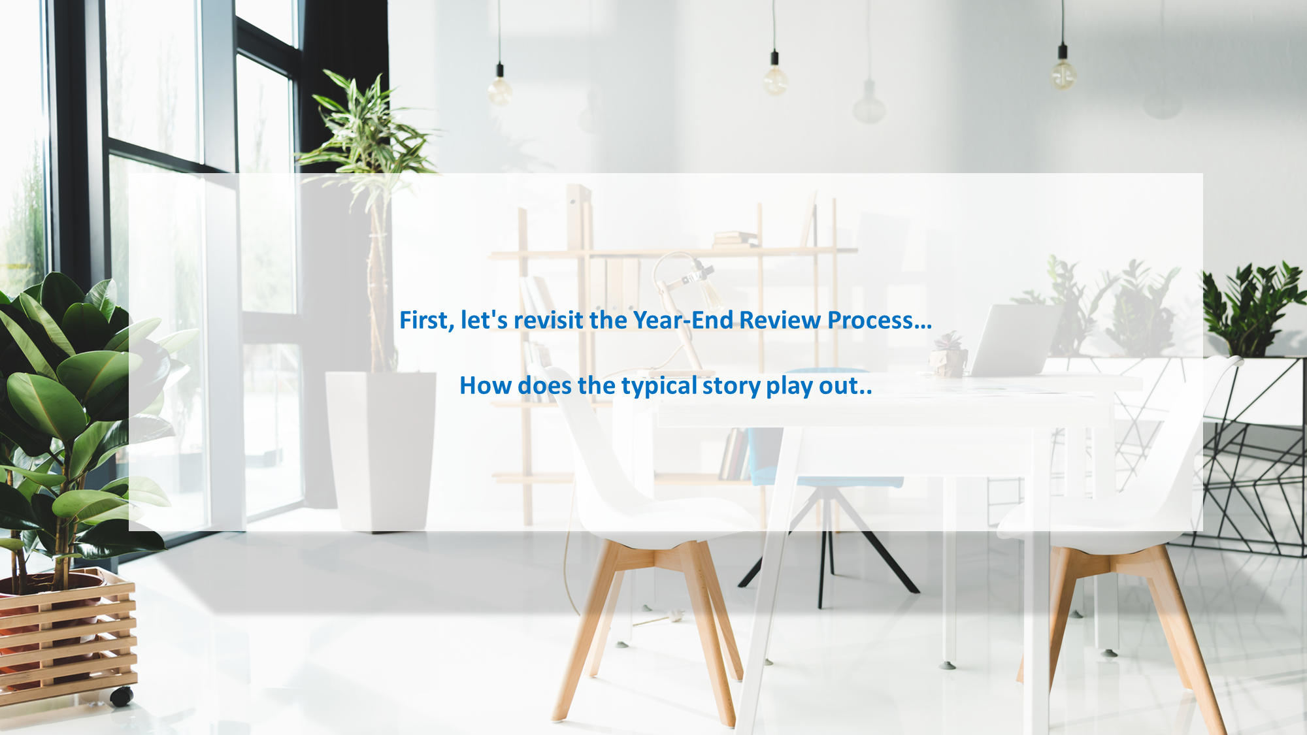

Slide 41


Continuous Performance Management
Meet Sameera
Department head
Meet Ahmed
Department Manager
Notes:
.

Slide 42
Sameera thinks Ahmed has been an average employee over this year; he didn’t achieve some of his goals and she is certain the final rating should be Partially Met Expectations

Slide 43
Ahmed has completed his self-assessment. He thinks he has performed exceptionally well! therefore he rated himself Exceeded Expectations in all his goals!

Slide 44
During the review meeting; Sameera begins to explain to Ahmed the reasons his goals were not met and provides some feedback on his performance.
Ahmed gets upset; he did not expect this.. he was frustrated he was never told about any issues before.
The meeting did not go well…

Slide 45
What do you think Sameera could have done better?

Slide 46
Continuous Conversation
The key is to position performance management and ongoing feedback discussions as crucial to achieve organizational strategic priorities.
As a Manager you are accountable for ongoing feedback
As a manager you Hold your employees accountable for scheduling and setting the agenda for performance conversations.
As a manager you need to use SuccessFactors to keep track of check-ins and goal progress
As a manager you need to use the training and resources available to both you and your teams!
As an Employee you are accountable for updating your progress and tracking of your goals
As an Employee schedule and set the agenda for performance conversations.
As an Employee use SuccessFactors to keep track of your activities and achievements and goal progress
As an Employee use the training and resources available to you

Slide 47
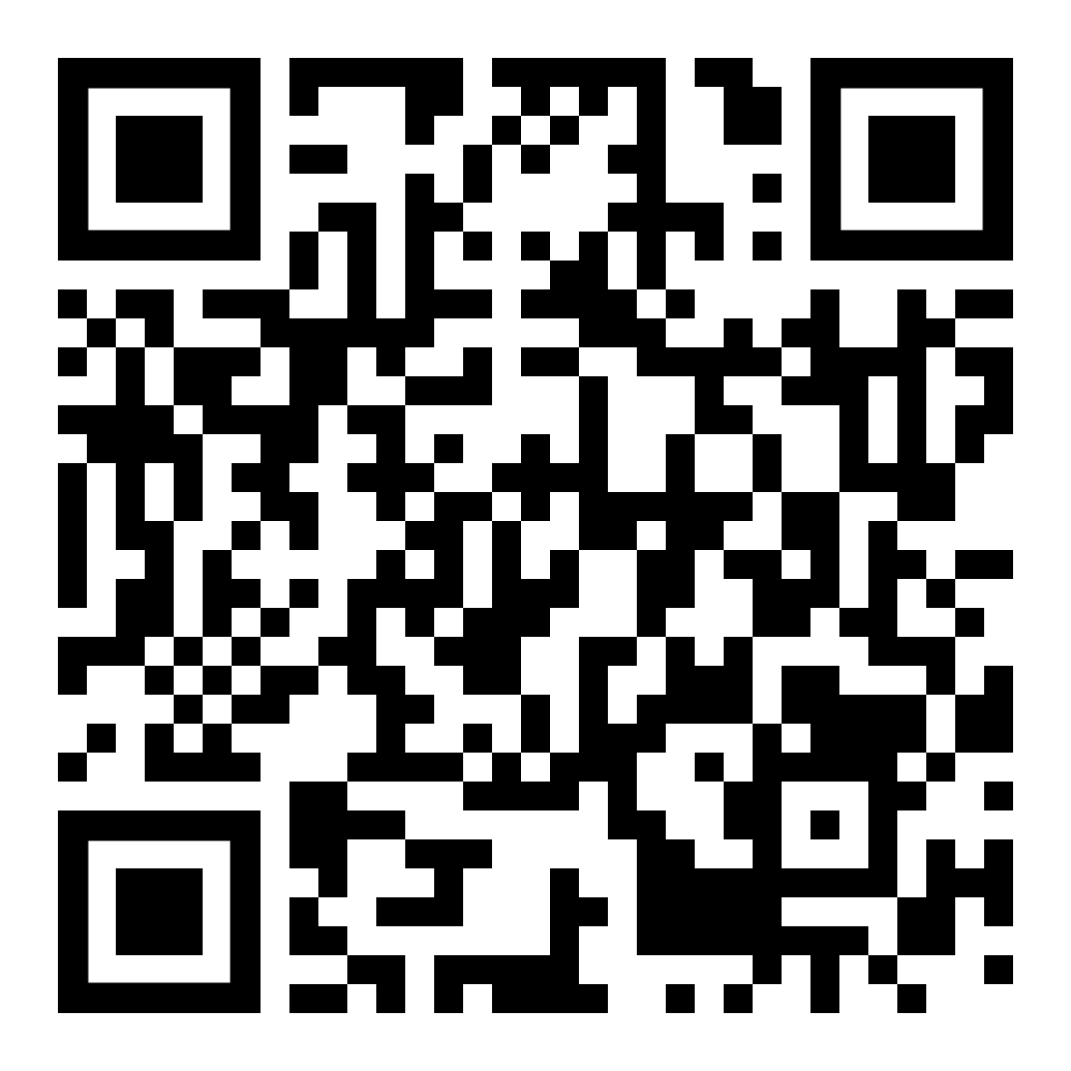
So how do we use the CPM tool
Please scan the QR code and go through the simulation and understand how to navigate it
Notes:
Please scan it and go through the simulation and understand how to navigate it

Slide 48

Let’s practice

Slide 49
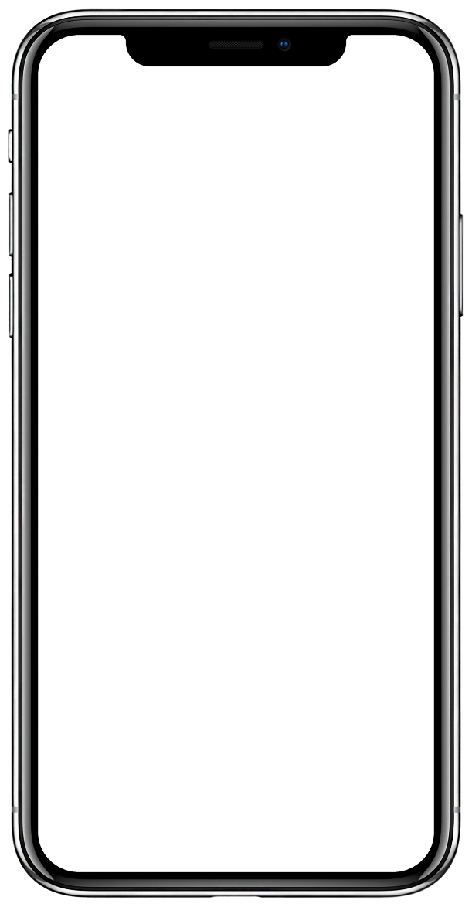
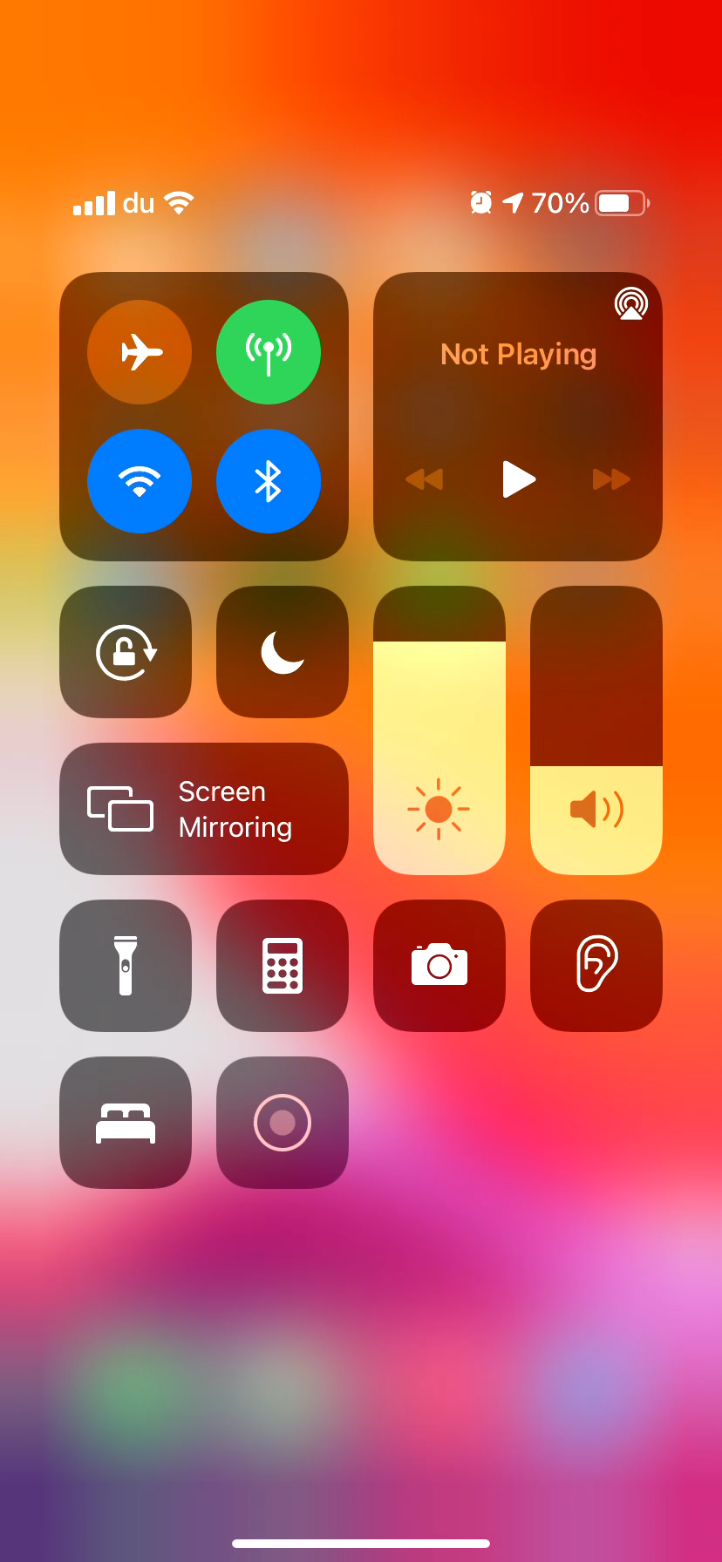
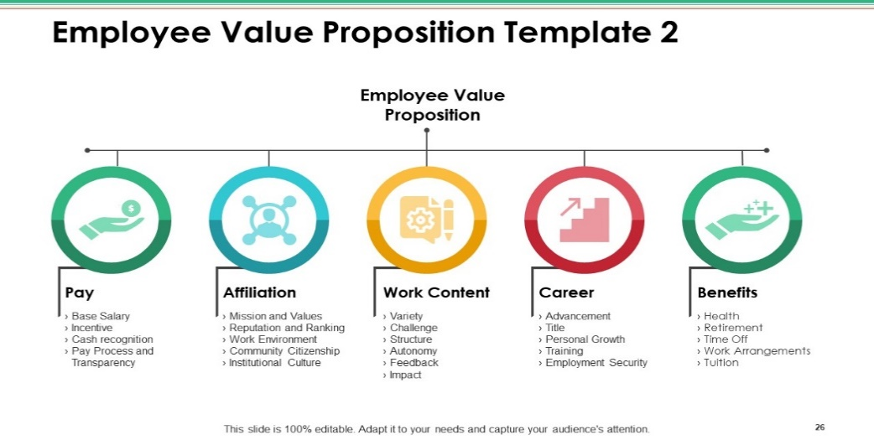
Download the success factors app
Where do I start?
1
Before we begin, download the App so you can get started!
2
Search for the SuccessFactors on the App Store (for IOS devices) or Play Store (for Android devices)
3
Once downloaded, open the SuccessFactors app on your device

Slide 50

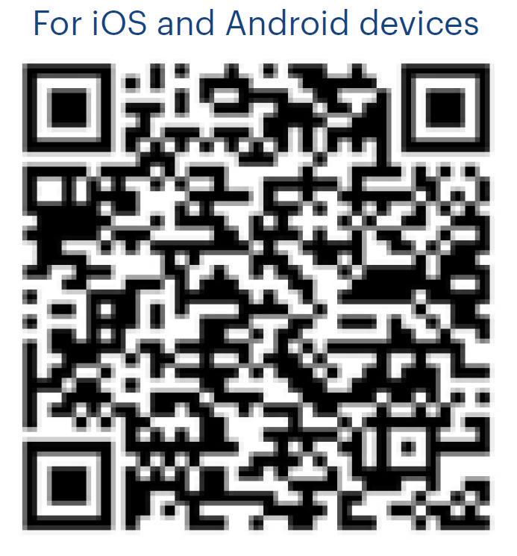

Download the success factors app
Tap on the ‘Log In with QR Code’ and scan then sign in!

Slide 51






Activities Status Achievements
High: Really need to get this done as
soon as possible
Medium: On my radar, but it could wait a day or two
Low: I’ll get to it when I have time
Paused: Something got in the way and it’s on hold
Cancelled: No longer happening but
want to preserve
Complete: I did it! Time to celebrate.
Creating a new product
Created and launched a new product
Selling to a potential customer
Landed a new customer
Link your activity to one of your performance and/or development goals
Writing a business plan
Volunteered to build new playground for community
Notes:
Activities are the things you are working on. Achievements in many cases represent the completion of an activity

Slide 52
Next steps
Implement your action(s)
Role-model effective practices of continuous Performance management
Develop your capabilities in having effective conversations around your Performance, Development and growth
Start your conversation today!!!

Slide 53
TODAY’s CAREER SUCCESS
Own your journey – it’s your career
Know your purpose and values – they define your unique journey
Have a growth and development mindset – gather skills, experiences and expertise
Reinvent your professional self – as things change so must you
Be a lifelong learner
– it will bring lifelong employability
Leverage the tools – make sure you are ready
YOUR CAREER IS a JOURNEY NOT A DESTINATION

